Slide 1
Weather Unit
By: Justin Wilson

Slide 2
Vocabulary
Wind gage- a tool used to meres wind.
Global warming- the warming of earths atmespher.

Slide 3
Comprehension Activity
Lighting
. Lighting hits the tallest thing.
.lighting comes after thunder
.lighting comes from the ground.

Slide 4
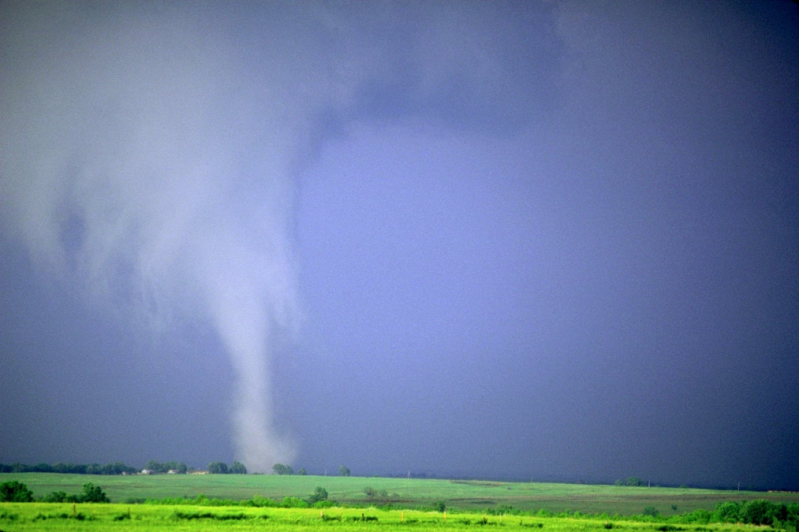
Lab Idea
Recreate a tornado.
Use plastic bottles , sugar , and other itmes

